Slide 1
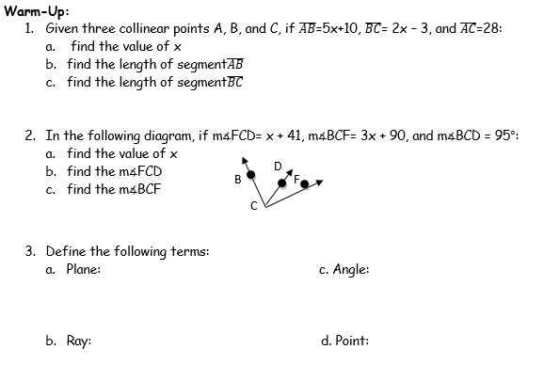

Slide 2
I can determine the measure of complementary, supplementary, and linear pair angles
G102-1

Slide 3
Useful Vocabulary
Acute angle: an angle whose measure is less than $90°$.
Obtuse angle: an angle whose measure is greater then $90°$, but less than $180°$.
Straight angle: an angle whose measure is exactly $180°$ (a straight line).
Linear Pair: two adjacent angles whose non-common sides are on the same line.

Slide 4
Right angle: angle whose measure is 90$°$.
Complementary angles: two angles that add up to 90$°$.
Supplementary angles: two angles that add up to 180$°$.

Slide 5
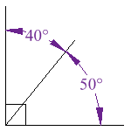
Complementary Angles
always add up to 90
are most often adjacent, or next to, each other, and make up a right angle.

Slide 6
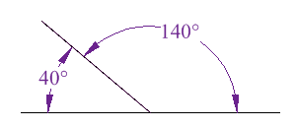
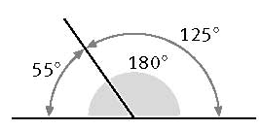
Supplementary Angles
always add up to 180
are most often adjacent, or next to each other, and form a linear pair
A linear pair is two angles that are adjacent, and supplementary.

Slide 7
Examples
1. Given that two angles, ∡ABC and ∡DEF, are
complementary, if m∡DEF is 60, what is the
measure of ∡ABC?
2. Given that two angles, ∡LMN and ∡HOT, are
supplementary, if m∡LMN is 53, what is the
measure of ∡HOT?

Slide 8
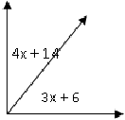
3. Based on the following diagram of two adjacent angles that
are complementary, find the value of x, and the measure of
each angle.
4. Based on the following diagram of two adjacent angles that
are supplementary, find the value of x, and the measure of
each angle.

Slide 9
5.Two angles, ∡MAT, and ∡TOP, are supplementary angles. The m∡MAT = x+12, and the m∡TOP = 6x+7. Find the measures of ∡MAT, and ∡TOP. Explain how you reached your answer.
6. Two angles,∡MAJ and ∡JAG are complementary. If the m∡MAJ = 4x-12, m∡JAG= 30°, Find the value of x, and the measure of ∡MAJ. Explain how you reached your answer.

Slide 10
Try on your own
Determine if the following statements are true
or false. Explain your reasoning.
1. If ∡XYZ and ∡WIN are complementary, then ∡XYZ and ∡WIN are a linear pair.
2. If ∡MAG and ∡SLK are supplementary, then
the sum of the measures of these two angles
is 90.

