Slide 1
G102-2: I can determine the measures of vertical angles Warm-Up:

Slide 2
Useful Vocabulary:
Vertical Angles: a pair of non-adjacent angles formed by the intersection of two straight lines.

Slide 3
Vertical Angles
s
1
4
2
3
t
Important Facts:
When two lines intersect, four angles are formed. The angles opposite each other are referred to as vertical angles.
When two lines intersect, their intersection is a point.

Slide 4
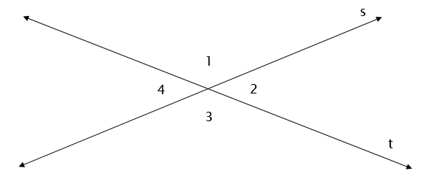
Properties of Vertical Angles
They are congruent(have the same measure)
∡1 ≅∡2 and ∡3≅∡4
The sum of both pairs of vertical angles (all four angles) is 360°.
m∡1+m∡2+m∡3+m∡4=360°
One angle from each pair of vertical angles, are adjacent angles, and are supplementary.
∡1 and ∡4 are supplementary
∡1 and ∡3 are supplementary
∡3 and ∡2 are supplementary
∡2 and ∡4 are supplementary

Slide 5
Examples

Slide 6
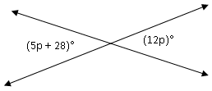
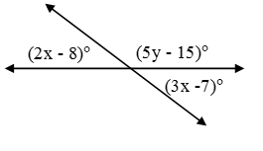
4.
5.

Slide 7
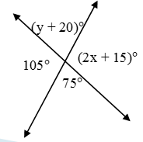
6.
7.

Slide 8
8.

Slide 9
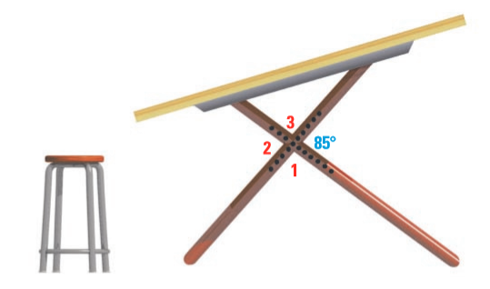
9. The intersecting legs of the draft table below intersect and form four angles. Based on the diagram below, find the measure of the remaining three angles.

